Slide 1


Pre-K Director Updates
2025-2026 School year
July 21, 2025
Notes:
---
This presentation provides essential updates and requirements for Pre-K directors to prepare effectively for the 2025-2026 school year. Topics include preparations, system guidance, grant processes, calendar submissions, teacher information, and updated guidelines.

Slide 2

Preparing for the New School Year
GAPREK System Guidance and User Support
Grant Agreement Process and Deadlines
Calendar Submission and Approval Process
Teacher Information Entry and Credential Waivers
Creditable Years of Experience (CYE) Management
2025-2026 Guidelines, Rate Charts, and Teacher Salary Information
Important Dates
Notes:
---
We will cover key topics including essential preparations, GAPREK system guidance, grant agreement processes, calendar submission procedures, teacher information entry, experience management, Work Sampling Online updates, and guidelines for the 2025-2026 school year.
Image source: Microsoft 365 content library

Slide 3

Preparing for the New School Year
Notes:
---
This slide references information from the following file: https://gadecal-my.sharepoint.com/personal/susan_adams_decal_ga_gov/_layouts/15/Doc.aspx?sourcedoc=%7B515CF2F7-3F0F-44E7-AF0D-CDB65261A10D%7D&file=Director%20Email%20July%202025.docx&action=default&mobileredirect=true&DefaultItemOpen=1
Important tasks and eligibility requirements for August payment, Pre-K Director webinar details and registration process

Slide 4
FY26 Pre-K Budget Changes- Public Schools Benefits
Benefit changes impacting lead teachers employed by public schools.
Increase in Teacher Retirement System from 20.78% to 21.91%
Increase to $1,885 per-member, per-month (PMPM) rate for certified lead teachers who participate in the State Health Benefit Program.
Notes:
PMPM for 12 months is $22,250, $1885 per month

Slide 5

Be Ready for the August Payment!
To be included in the August payment run, these tasks must be completed.
Grant Agreement Execution – Due July 21st
  An executed grant agreement is required for eligibility to receive the August payment.
Class Calendars – Due July 25th
  Each class must have a calendar submitted and approved before payment eligibility.
Teacher Information in CRM – Due July 25th
  Lead and assistant teachers must be entered into the Class Reporting Manager for each class.
Notes:
---
This slide references information from the following file: https://gadecal-my.sharepoint.com/personal/susan_adams_decal_ga_gov/_layouts/15/Doc.aspx?sourcedoc=%7B515CF2F7-3F0F-44E7-AF0D-CDB65261A10D%7D&file=Director%20Email%20July%202025.docx&action=default&mobileredirect=true&DefaultItemOpen=1
We hope you are enjoying your summer. The Pre-K Team is diligently preparing for the upcoming school year.
As we approach the start of the new school year, please review the following program information and updates. There are several important tasks to complete to ensure your program remains current and meets all deadlines for the new school year. To ensure you are eligible to receive your August payment, you must have an executed grant agreement, an approved calendar for each class, and teachers (lead and assistant) entered into the Class Reporting Manager (CRM) for each class.
Image source: Microsoft 365 content library

Slide 6
GAPREK System Guidance and User Support
Notes:
---
This slide references information from the following file: https://gadecal-my.sharepoint.com/personal/susan_adams_decal_ga_gov/_layouts/15/Doc.aspx?sourcedoc=%7B515CF2F7-3F0F-44E7-AF0D-CDB65261A10D%7D&file=Director%20Email%20July%202025.docx&action=default&mobileredirect=true&DefaultItemOpen=1
Daily notifications, readiness checklist, and user updates in GAPREK, Accessing GAPREK user guides for assistance

Slide 7
It was a challenging year…

Slide 8

GAPREK Enhancements
Improved Bulk Upload Process
  You will be able to enter student data more quickly and efficiently. This is scheduled for release in mid-August.
Access to Visit Reports
  Making it easier for you to review your feedback and access any follow up documents.
Notes:
Improved Bulk Upload Process – Your providers will now have a faster and more efficient way to enter student data.
Access to Visit Reports – Providers will be able to acknowledge, access, and download visit reports.
School Calendars - Providers can now select multiple dates at once for each calendar category by using the “Add Date” button to select all relevant dates (e.g., holidays), save, and move to the next category.
"Did Not Return" button – Allows providers to remove teachers who did not return for the upcoming school year.
GaPDS Number will now be required for Teacher Entry. This will reduce the number of duplicates in the system.

Slide 9
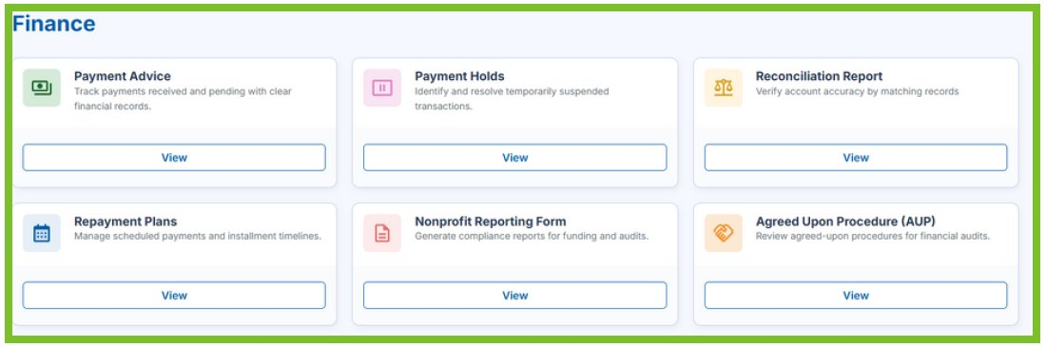
New Finance Section!
You will be able to view payment holds, payment advices, reconciliation reports, repayment plans, and Agreed Upon Procedures under one tab.

Slide 10
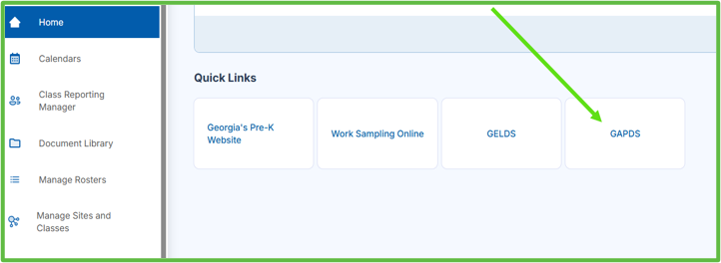
Enhancement: Training Registration
You are able to register through GaPDS via the GAPREK Dashboard!

Slide 11

Changes to Help Desk Ticket Categories
Help Desk Categories: Now Updated
You can now create help desk tickets for the following categories:
Applications
Calendars
Change of Ownership
GAPREK Login, Data, User Issues
Grant Agreement
Payment
Reconciliation
Summer Transition Program
Training
WSO
General Questions

Slide 12

System Notifications
  Regularly check GAPREK for notifications and messages to stay updated on important tasks to complete.
Provider Readiness Checklist
  Follow the GAPREK Provider Readiness Checklist which outlines a timeline to prepare effectively for the school year.
Notes:
---
This slide references information from the following file: https://gadecal-my.sharepoint.com/personal/susan_adams_decal_ga_gov/_layouts/15/Doc.aspx?sourcedoc=%7B515CF2F7-3F0F-44E7-AF0D-CDB65261A10D%7D&file=Director%20Email%20July%202025.docx&action=default&mobileredirect=true&DefaultItemOpen=1
· As the school year approaches, you should be checking the GAPREK system daily for notifications and messages about tasks to complete in the system.
· The GAPREK Provider Readiness Checklist outlines a timeline to help you prepare for the school year.
· GAPREK: User Updates: Please review your GAPREK users and update any changes in roles and contact information. The Primary Authorized User (PAU) can add/update project directors, site directors, financial users, and data entry staff in the system.
Image source: Microsoft 365 content library

Slide 13

Updating Users
User Updates and Management:
  Primary Authorized Users (PAU) can update roles and contact information for project directors, site directors, financial users, and data entry staff.
  If your PAU needs to be changed, complete a new Online Access Form must be completed and submitted.

Slide 14
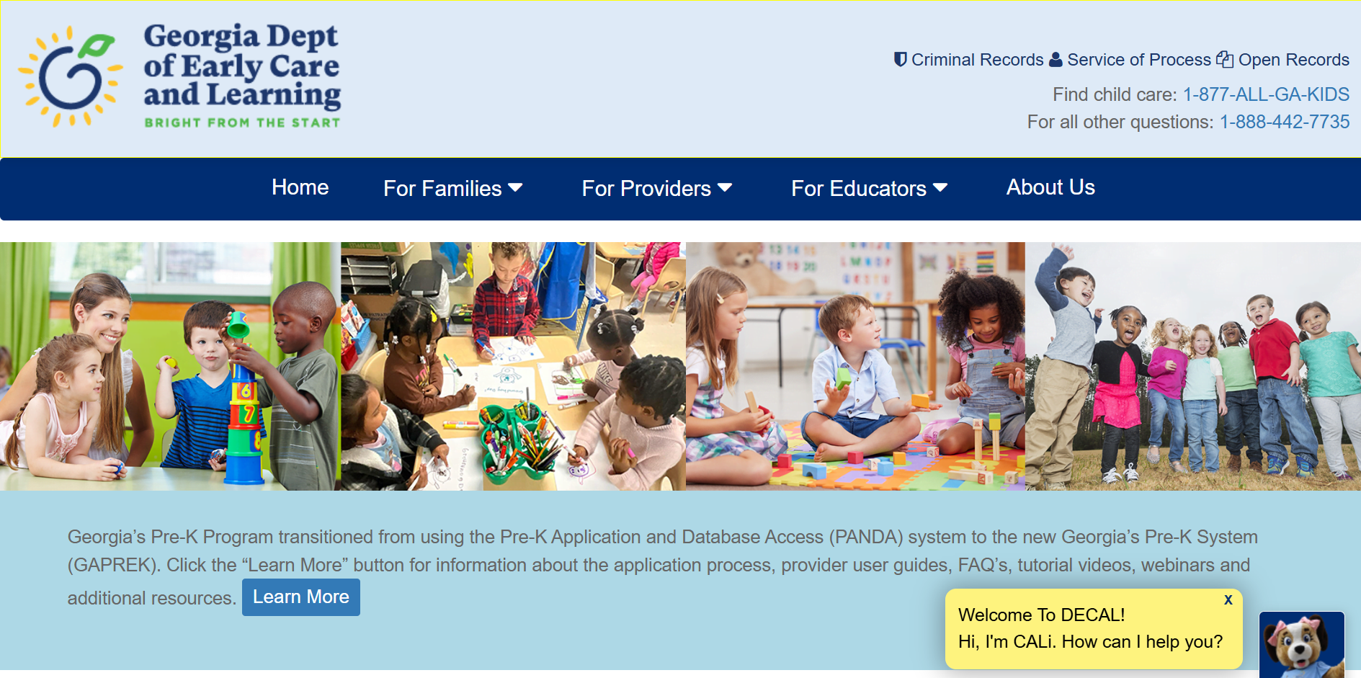
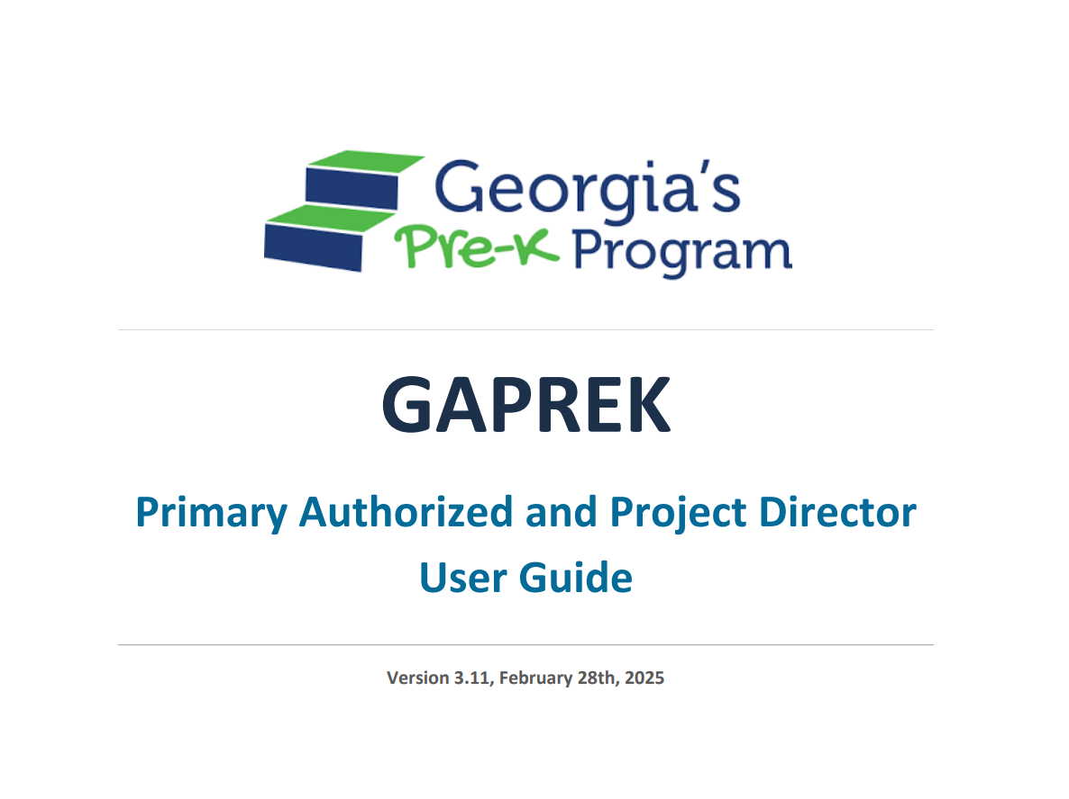
GAPREK Support
User Guides:
  GAPREK User Guides provide detailed instructions for using the provider portal effectively
  All user guides are located on the GAPREK webpage
Email Support:​
Email gaprek.support@decal.ga.gov for assistance.
Notes:
---
This slide references information from the following file: https://gadecal-my.sharepoint.com/personal/susan_adams_decal_ga_gov/_layouts/15/Doc.aspx?sourcedoc=%7B515CF2F7-3F0F-44E7-AF0D-CDB65261A10D%7D&file=Director%20Email%20July%202025.docx&action=default&mobileredirect=true&DefaultItemOpen=1
· For assistance, refer to the GAPREK User Guides: https://www.decal.ga.gov/PreK/ProviderPortalUserGuides.aspx
Image source: Microsoft 365 content library

Slide 15
Grant Agreement Process and Deadlines
Notes:
---
This slide references information from the following file: https://gadecal-my.sharepoint.com/personal/susan_adams_decal_ga_gov/_layouts/15/Doc.aspx?sourcedoc=%7B515CF2F7-3F0F-44E7-AF0D-CDB65261A10D%7D&file=Director%20Email%20July%202025.docx&action=default&mobileredirect=true&DefaultItemOpen=1
Executed grant agreements deadline and steps to receive agreements, Grant agreement procedures by program type (Table), Contact information for grant agreement issues

Slide 16

Grant Agreement Deadline
Grant Agreement Deadline
  Grant agreements must be signed and returned by Monday, July 21st.
  Steps to Receiving Grants
  Once the Verification of Lawful Presence or Delegation of Authority is complete in GAPREK, the grant agreement is sent to the Grant Signatory via DocuSign.
  If you have not received your grant, please email prekbusiness.support@decal.ga.gov for support.
Notes:
---
This slide references information from the following file: https://gadecal-my.sharepoint.com/personal/susan_adams_decal_ga_gov/_layouts/15/Doc.aspx?sourcedoc=%7B515CF2F7-3F0F-44E7-AF0D-CDB65261A10D%7D&file=Director%20Email%20July%202025.docx&action=default&mobileredirect=true&DefaultItemOpen=1
2025-2026 Pre-K Grants: Executed Grant Agreements are due by Monday, July 21st
· See the chart below to determine the steps needed to receive your grant agreement.
Image source: Microsoft 365 content library

Slide 17

Calendars
Notes:
---
This slide references information from the following file: https://gadecal-my.sharepoint.com/personal/susan_adams_decal_ga_gov/_layouts/15/Doc.aspx?sourcedoc=%7B515CF2F7-3F0F-44E7-AF0D-CDB65261A10D%7D&file=Director%20Email%20July%202025.docx&action=default&mobileredirect=true&DefaultItemOpen=1
Calendar due date and entry instructions, Video resource for calendar creation, Support and approval process for Pre-K calendars

Slide 18

Calendars are open
  You can now enter your Pre-K calendar into the GAPREK system for approval.
How to create your calendar
  Instructions for creating calendars can be accessed via a tutorial video located on the GAPREK webpage.
  https://www.decal.ga.gov/PreK/PreKPortal.aspx .
Calendar due date
  The calendar due date is Friday, July 25th
  Need help
  Contact your Pre-K Specialist for help with creating and submitting your calendar.
Notes:
---
This slide references information from the following file: https://gadecal-my.sharepoint.com/personal/susan_adams_decal_ga_gov/_layouts/15/Doc.aspx?sourcedoc=%7B515CF2F7-3F0F-44E7-AF0D-CDB65261A10D%7D&file=Director%20Email%20July%202025.docx&action=default&mobileredirect=true&DefaultItemOpen=1
Calendars: The calendar due date is Friday, July 25th.
· You are now able to enter your Pre-K calendar into GAPREK.
· For instructions on creating calendars, view this video https
Image source: Microsoft 365 content library

Slide 19
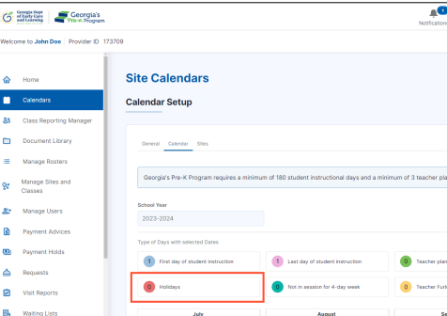
Calendar Process
Review and Notification
  After submission, your Pre-K Specialist will review your calendar, and you will be notified of approval or any revision that is needed.
Next Steps
  Only calendars with an approved status ensure payment for the respective Pre-K classes.
Notes:
---
This slide references information from the following file: https://gadecal-my.sharepoint.com/personal/susan_adams_decal_ga_gov/_layouts/15/Doc.aspx?sourcedoc=%7B515CF2F7-3F0F-44E7-AF0D-CDB65261A10D%7D&file=Director%20Email%20July%202025.docx&action=default&mobileredirect=true&DefaultItemOpen=1
· If you need assistance with creating your calendar, please contact your Pre-K Specialist.
· Once submitted, your Pre-K Specialist will receive a notification to review your calendar. Once they have reviewed it, you will receive a notification in GAPREK with approval or a request for revision.
· Only classes with a calendar in an approved status will be paid.
Image source: Microsoft 365 content library

Slide 20
Teacher Information Entry and Credential Waivers
Notes:
---
This slide references information from the following file: https://gadecal-my.sharepoint.com/personal/susan_adams_decal_ga_gov/_layouts/15/Doc.aspx?sourcedoc=%7B515CF2F7-3F0F-44E7-AF0D-CDB65261A10D%7D&file=Director%20Email%20July%202025.docx&action=default&mobileredirect=true&DefaultItemOpen=1
Teacher entry deadline and GAPREK data entry process, GaPDS number requirement and payment eligibility, Teacher credential waiver types and application process, Entering waivered teachers and payment procedures

Slide 21
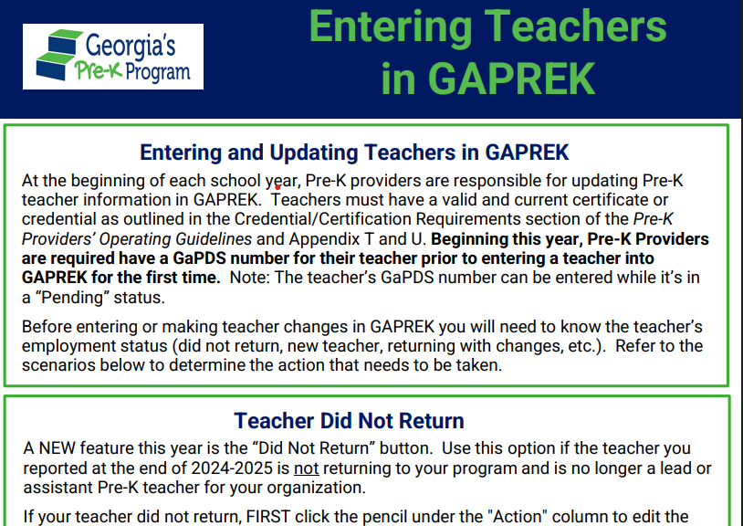
Entering Teacher Information in the Class Reporting Manager (CRM)
New Resource!
Entry Deadline
  The deadline for teacher (lead and assistant) data entry is Friday, July 25th. Only classes with a lead and assistant teacher entered will be eligible for an August payment.
  Support Resource
  Entering Teachers in GAPREK is a resource to provide guidance in entering and updating teacher data.
Notes:
---
This slide references information from the following file: https://gadecal-my.sharepoint.com/personal/susan_adams_decal_ga_gov/_layouts/15/Doc.aspx?sourcedoc=%7B515CF2F7-3F0F-44E7-AF0D-CDB65261A10D%7D&file=Director%20Email%20July%202025.docx&action=default&mobileredirect=true&DefaultItemOpen=1
Entering Teacher Information: The deadline for entering teachers is Friday, July 25th
· The GAPREK Teacher Information Screen is open for teacher data entry.
· Entering Teachers in GAPREK is a resource to support you in entering and updating teachers.
Image source: Microsoft 365 content library

Slide 22

New Functionality This year:
  GaPDS number requirement
  A GaPDS number is required to enter new teachers in the system. The PDS number is issued when a teacher creates their profile.
Did Not Return button
  Use this option if the teacher you reported at the end of 2024-2025 is not returning to your program and is no longer a lead or assistant Pre-K teacher for your organization.
Notes:
---
This slide references information from the following file: https://gadecal-my.sharepoint.com/personal/susan_adams_decal_ga_gov/_layouts/15/Doc.aspx?sourcedoc=%7B515CF2F7-3F0F-44E7-AF0D-CDB65261A10D%7D&file=Director%20Email%20July%202025.docx&action=default&mobileredirect=true&DefaultItemOpen=1
· New this school year: A GaPDS number is required to enter new teachers in the system. The PDS number is provided once the teacher creates the account.
· Only classes with a lead and assistant teacher entered will be paid.
Image source: Microsoft 365 content library

Slide 23

Teacher Credential Waivers
Teacher Credential Extension Waiver
  Teachers eligible for an extension waiver must have been waivered during the 2024-2025 school year and will have not completed a qualifying credential by fall 2025. Continued enrollment in a credentialing program is required.
Credential Waiver for New Teachers
  This waiver is for teachers newly employed by your program who do not meet the credential requirement. Enrollment in a credentialing program is required prior to submitting the waiver request.
Notes:
---
This slide references information from the following file: https://gadecal-my.sharepoint.com/personal/susan_adams_decal_ga_gov/_layouts/15/Doc.aspx?sourcedoc=%7B515CF2F7-3F0F-44E7-AF0D-CDB65261A10D%7D&file=Director%20Email%20July%202025.docx&action=default&mobileredirect=true&DefaultItemOpen=1
Requests for Teacher Credential Waivers
· The Teacher Credential Extension Waiver and Teacher Credential Waiver are available in GAPREK in the Waivers section. Please refer to the Primary Authorized and Project Director User Guide to help you submit a waiver application.
· Teacher Credential Extension Waiver: Submit for a currently waivered teacher returning to your program who will not hold a qualifying credential in fall 2025. The teacher must be enrolled in a credentialing program prior to submission of the extension request.
· Teacher Credential Waiver: Submit for a teacher who is new to your program. The teacher must be enrolled in a credentialing program prior to submission of the waiver request.
Image source: Microsoft 365 content library

Slide 24
Submission Guidance
  Refer to the Primary Authorized and Project Director User Guide to assist with submitting a waiver request in GAPREK.
Payment Eligibility
  Teachers must be entered into the CRM prior to submitting a teacher credential waiver request.
Retroactive Salary Adjustment
  If the waiver is approved, any applicable retroactive salary adjustments will be processed if applicable.
Waiver Process, Approvals, and Payments
Notes:
---
This slide references information from the following file: https://gadecal-my.sharepoint.com/personal/susan_adams_decal_ga_gov/_layouts/15/Doc.aspx?sourcedoc=%7B515CF2F7-3F0F-44E7-AF0D-CDB65261A10D%7D&file=Director%20Email%20July%202025.docx&action=default&mobileredirect=true&DefaultItemOpen=1
· Once you have applied for a waiver, enter the teacher into the CRM. Teachers must be entered to receive an August payment. Once approved, their salary will be retroed if appropriate.
Image source: Microsoft 365 content library

Slide 25
Creditable Years of Experience (CYE) Management
Notes:
---
This slide references information from the following file: https://gadecal-my.sharepoint.com/personal/susan_adams_decal_ga_gov/_layouts/15/Doc.aspx?sourcedoc=%7B515CF2F7-3F0F-44E7-AF0D-CDB65261A10D%7D&file=Director%20Email%20July%202025.docx&action=default&mobileredirect=true&DefaultItemOpen=1
Automatic CYE increase for returning teachers, CYE verification and change request process

Slide 26

Automatic CYE increase for returning teachers
Eligibility for Automatic Increase
  Returning teachers teaching at least 60% of the 2024-2025 year qualify for an automatic CYE increase.
Automatic System Update
CYE will be automatically increased by one year at the end of July. Providers should not add a year in the system.
Notes:
---
This slide references information from the following file: https://gadecal-my.sharepoint.com/personal/susan_adams_decal_ga_gov/_layouts/15/Doc.aspx?sourcedoc=%7B515CF2F7-3F0F-44E7-AF0D-CDB65261A10D%7D&file=Director%20Email%20July%202025.docx&action=default&mobileredirect=true&DefaultItemOpen=1
· At the end of July, returning Pre-K teachers who taught at least 60% of the 2024-2025 year will automatically be increased by one year in GAPREK. Providers do not need to add a year in the system.
Image source: Microsoft 365 content library

Slide 27

CYE verification and change request process
CYE Verification
Only years of experience that have been verified by the employer should be entered into GAPREK. CYE audits are conducted by DECAL and program verification documentation used by the program may be requested.
CYE Change Request
To request CYE verification for a new teacher or a change in CYE for a returning teacher, submit the Creditable Years of Experience (CYE) Change Request Form and supporting documentation. The CYE Change Request Form is located in the Requests section of the GAPREK.
Notes:
---
This slide references information from the following file: https://gadecal-my.sharepoint.com/personal/susan_adams_decal_ga_gov/_layouts/15/Doc.aspx?sourcedoc=%7B515CF2F7-3F0F-44E7-AF0D-CDB65261A10D%7D&file=Director%20Email%20July%202025.docx&action=default&mobileredirect=true&DefaultItemOpen=1
· If you need to request CYE verification for a new teacher or a change in CYE for a returning teacher, please submit the Creditable Years of Experience (CYE) Change Request Form located in the Requests section of GAPREK.
Image source: Microsoft 365 content library

Slide 28
2025-2026 Guidelines, Rate Charts, and Teacher Salary Information
Notes:
---
This slide references information from the following file: https://gadecal-my.sharepoint.com/personal/susan_adams_decal_ga_gov/_layouts/15/Doc.aspx?sourcedoc=%7B515CF2F7-3F0F-44E7-AF0D-CDB65261A10D%7D&file=Director%20Email%20July%202025.docx&action=default&mobileredirect=true&DefaultItemOpen=1
Availability of Pre-K operating guidelines, Rate charts and budget information for providers, Teacher salary scale information

Slide 29
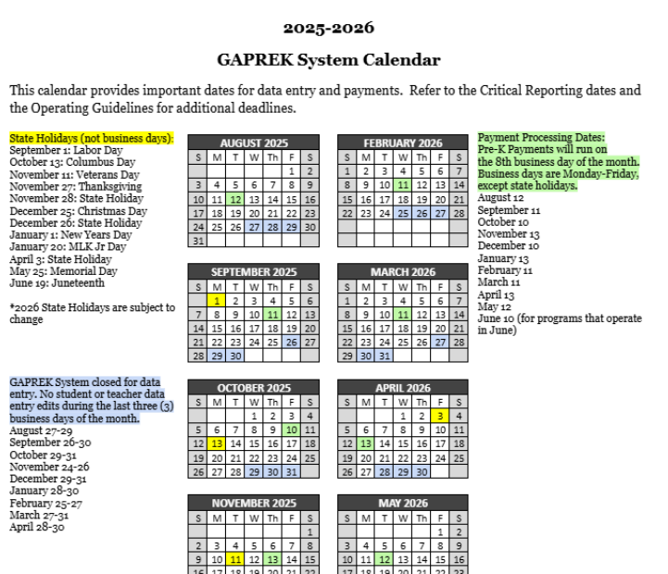
Pre-K Operating Guidelines​
The 2025-2026 Pre-K Operating Guidelines are available online for providers to ensure standardized program delivery.​
​
New this school year​
Payments will be processed on the 8th business day of the month.​
Teacher and student data entry in GAPREK is required prior to the last 3 business days of the month.​
​​
Refer to Appendix V for Critical Reporting Payment and Data Entry Dates​
Notes:
---
This slide references information from the following file: https://gadecal-my.sharepoint.com/personal/susan_adams_decal_ga_gov/_layouts/15/Doc.aspx?sourcedoc=%7B515CF2F7-3F0F-44E7-AF0D-CDB65261A10D%7D&file=Director%20Email%20July%202025.docx&action=default&mobileredirect=true&DefaultItemOpen=1
· Pre-K Operating Guidelines
o 2025-2026 School Year Pre-K Operating Guidelines can be found Pre-K Providers' Operating Guidelines (ga.gov).
Image source: Microsoft 365 content library

Slide 30

Rate charts and budget information for providers
Program Type Rate Charts:
  Private Programs and Other Public Providers https://www.decal.ga.gov/documents/attachments/PrivatePublicBudgetandRateChart.pdf
  Local School Systems https://www.decal.ga.gov/documents/attachments/PublicBudgetandRateChart.pdf
Notes:
---
This slide references information from the following file: https://gadecal-my.sharepoint.com/personal/susan_adams_decal_ga_gov/_layouts/15/Doc.aspx?sourcedoc=%7B515CF2F7-3F0F-44E7-AF0D-CDB65261A10D%7D&file=Director%20Email%20July%202025.docx&action=default&mobileredirect=true&DefaultItemOpen=1
· Rate Charts and Budget Information
o Private Programs and Other Public Providers https://www.decal.ga.gov/documents/attachments/PrivatePublicBudgetandRateChart.pdf
o Local School Systems https://www.decal.ga.gov/documents/attachments/PublicBudgetandRateChart.pdf
Image source: Microsoft 365 content library

Slide 31
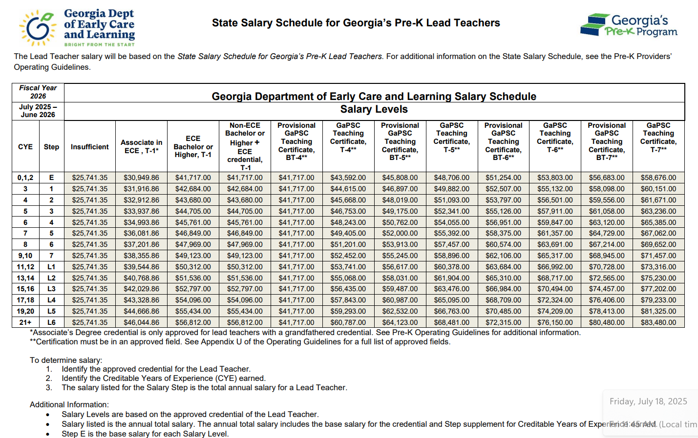
State Salary Schedule for Georgia's Pre-K Lead Teachers
Importance of Salary Transparency
  Transparent salary scales help teachers understand their compensation and career progression opportunities.
Annual Salary Information
  Annual salary is determined by the K-12 State Teacher Schedule and is based on the teacher’s verified credential(s) plus additional compensation for Salary Steps earned.
Notes:
---
This slide references information from the following file: https://gadecal-my.sharepoint.com/personal/susan_adams_decal_ga_gov/_layouts/15/Doc.aspx?sourcedoc=%7B515CF2F7-3F0F-44E7-AF0D-CDB65261A10D%7D&file=Director%20Email%20July%202025.docx&action=default&mobileredirect=true&DefaultItemOpen=1
· Teacher Salary Information
o 2025-2026 Teacher Salary Scale can be found https://www.decal.ga.gov/documents/attachments/2026StateTeacherSchedule.pdf
Image source: Microsoft 365 content library

Slide 32

Project Director Training
Location | Date
Northeast Georgia | August 19th
Georgia Piedmont College (Clarkston) | August 20th
Atlanta Metropolitan College | August 21st
Clarence Brown Conference Center (Cartersville) | August 22nd
Anderson Conference Center (Macon) | August 26th
UGA Conference Center (Tifton) | August 27th
Southeast Georgia | Week of August 25th
Training will be from 9:00-3:00 pm. Registration details coming soon!

Slide 33

Pre-K
Specialist Support
Pre-K regional meetings for teachers
Technical assistance visits
Site visits
Program visits

Slide 34
Important Dates
21 July
Grant Agreements Due
25 July
Calendar Due
25 July
Lead and assistant teachers must be entered into the Class Reporting Manager
1 Aug
Pre-K teacher training opens
4 Aug
WSO administrator logins will be reinstated
18 Aug
WSO teacher logins will be reinstated
12 Aug
August payment run

Slide 35

Questions

Slide 36

Thank You!
Susan Adams
Deputy Commissioner
Pre-K & Instructional Supports
Susan.Adams@decal.ga.gov
Prek@decal.ga.gov

