Slide 1
W-9 & Supplier(vendor) change request form Instructions

Slide 2
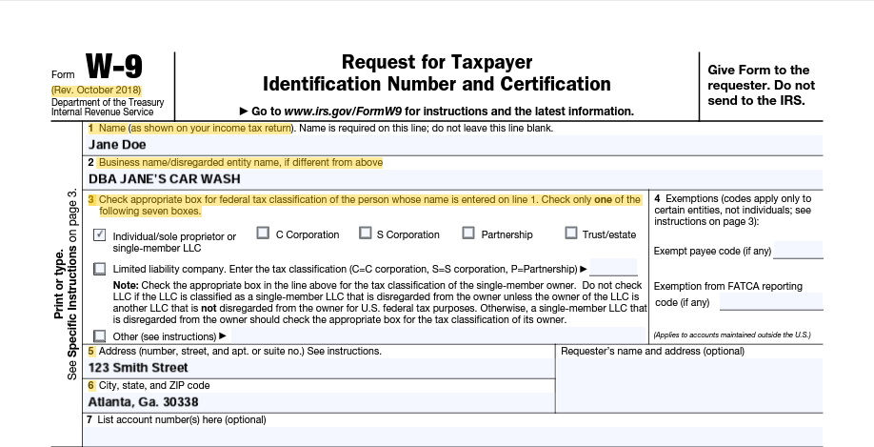
Steps to correctly complete a W-9 example 1- (individual/sole proprietor)
The name on line 1 must match with the name the IRS associates with the suppliers TIN
Line 2 is for Business name, trade name, or doing business as name. Disregarded entity name

Slide 3
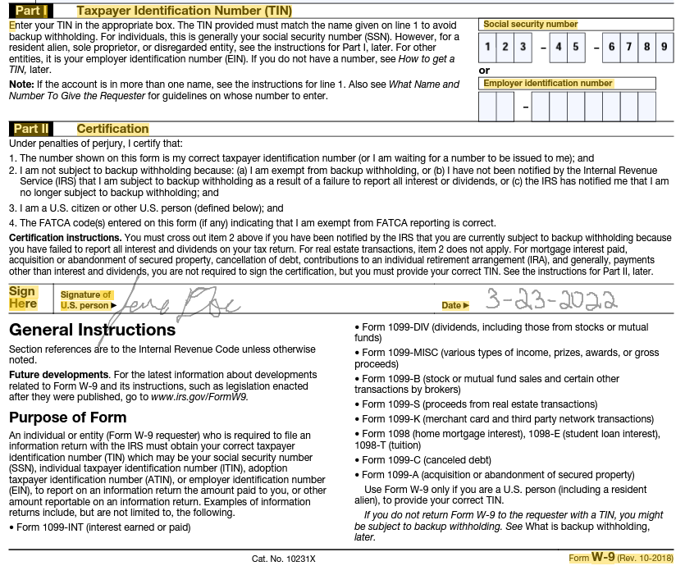

Steps to correctly complete a W-9
Example 1 - Using social security number (SSN)
Supplier should enter only ONE. Social Security Number – SSN or Employer Identification Number - EIN for taxpayer identification number in Part I. Depending on which one is appropriate.
By the supplier signing the W9 they attest that: The TIN given is correct.

Slide 4
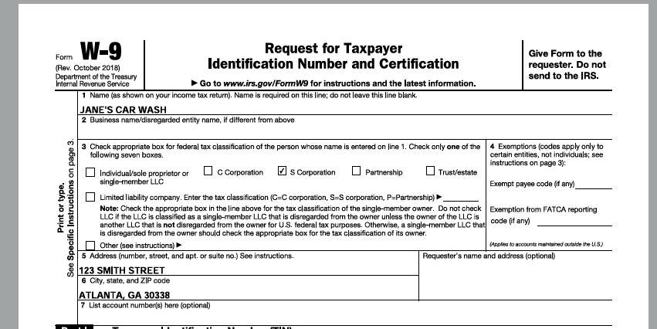
Steps to correctly complete a W-9 using
Example 2 – Using taxpayer identification number(tin) - S-Corporation
The name on line 1 must match with the name the IRS associates with the suppliers TIN.

Slide 5
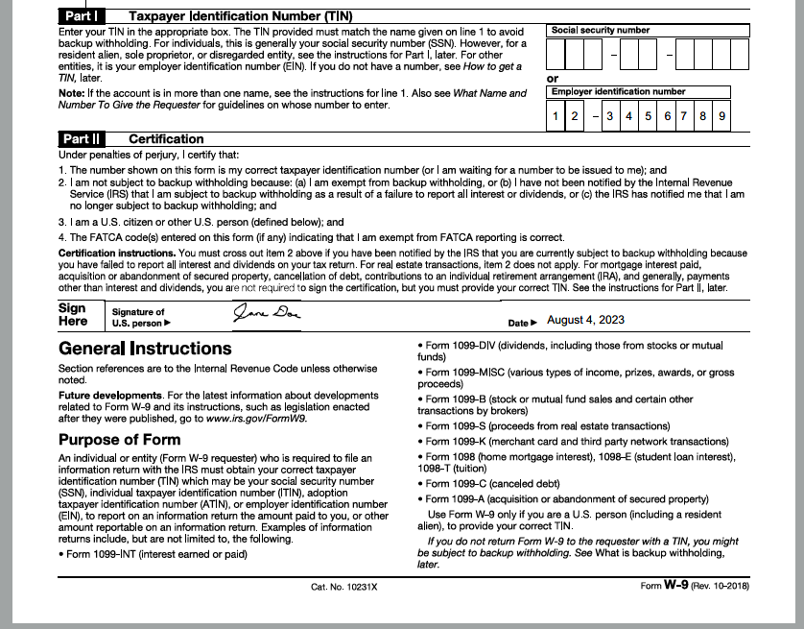
Steps to correctly complete a W-9 example 2 - using taxpayer identification number(tin) - S-Corporation
Supplier should enter only ONE. Social Security Number – SSN or Employer Identification Number - EIN for taxpayer identification number in Part I. Depending on which one is appropriate.
By the supplier signing the W9 they attest that: The TIN given is correct.

Slide 6
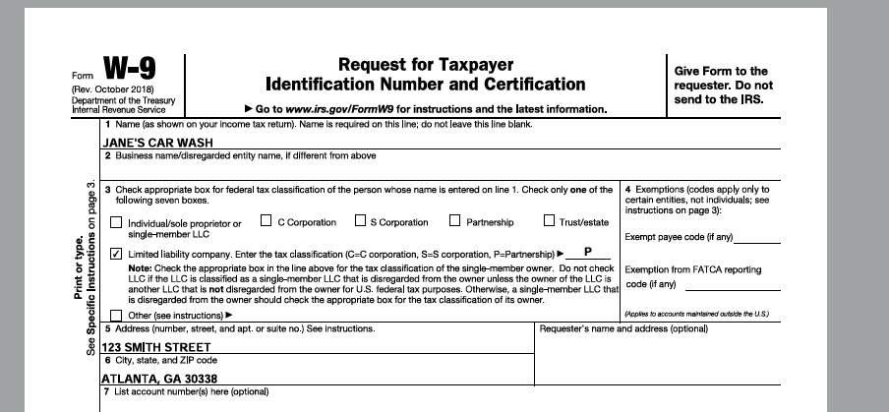
Steps to correctly complete a W-9 example 3 - using taxpayer identification number(tin) limited liability company
The name on line 1 must match with the name the IRS associates with the suppliers TIN
Line 3 If Limited Liability Company is checked supplier must enter tax classification (C, S, or P)

Slide 7
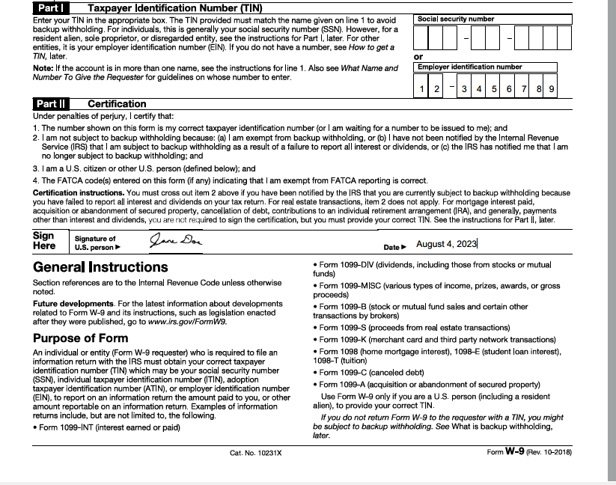
Steps to correctly complete a W-9 example 3 - using taxpayer identification number(tin) – Limited Liability Company
Supplier should enter only ONE. Social Security Number – SSN or Employer Identification Number - EIN for taxpayer identification number in Part I. Depending on which one is appropriate.
By the supplier signing the W9 they attest that: The TIN given is correct.

Slide 8
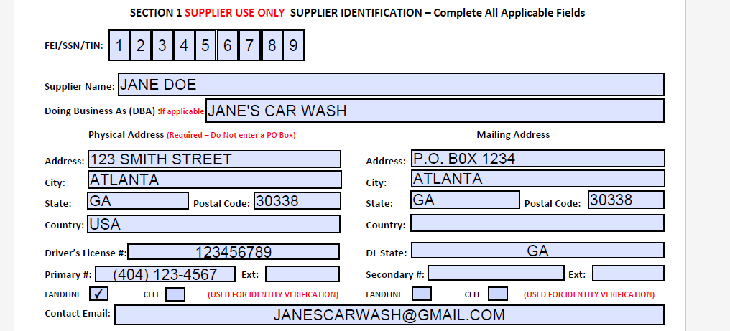
Supplier (vendor) change request form section 1(individual name with dba)
Supplier must file out Section 1 completely
The supplier’s name and DBA must match with the name the IRS associates with the suppliers TIN

Slide 9
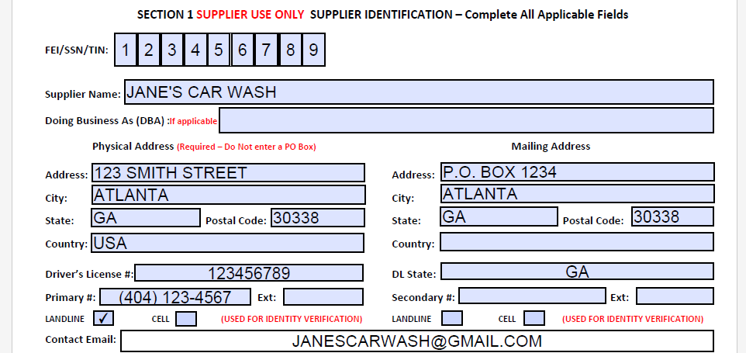
Supplier (vendor) change request form section 1(supplier name without dba)
Supplier must file out Section 1 completely
The supplier’s name must match with the name the IRS associates with the suppliers TIN

Slide 10
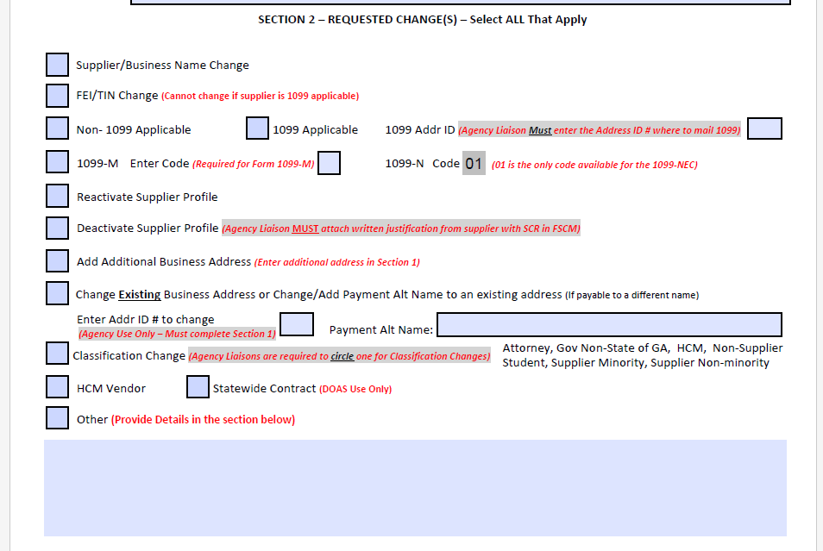
Supplier (vendor) change request form section 2
The vendor liaison with DECAL will fill out section 2

Slide 11
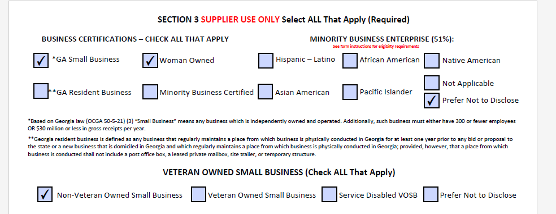
Supplier (vendor) change request form section 3
Supplier must file out Section 3 completely.
Something must be checked under Business Certifications, Minority Business Enterprise, and Veteran Owned Small Business
Supplier can check Not Applicable or Prefer Not to Disclose – but something must be checked in Section 3

Slide 12
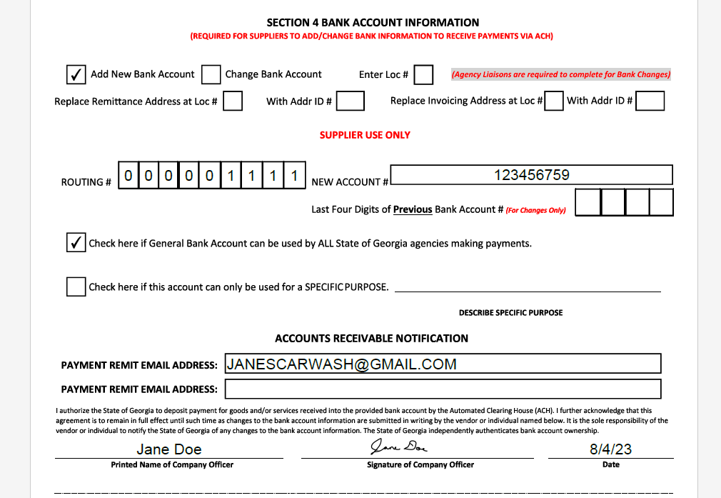
Supplier (vendor) change request form section 4 add new bank account – general bank account example
Supplier must file out Section 4 completely.
Supplier must check only one if General Bank Account or Specific Purpose.

Slide 13
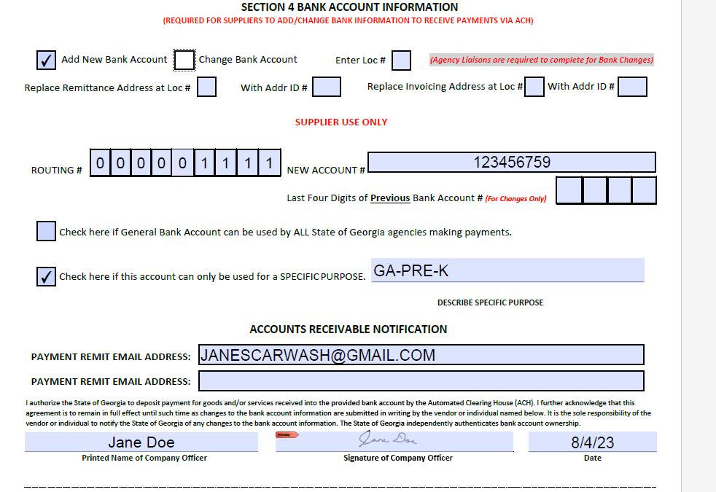
Supplier (vendor) change request form section 4 add new bank account – specific purpose example
Supplier must file out Section 4 completely.
Supplier must check only one if General Bank Account or Specific Purpose.

Slide 14
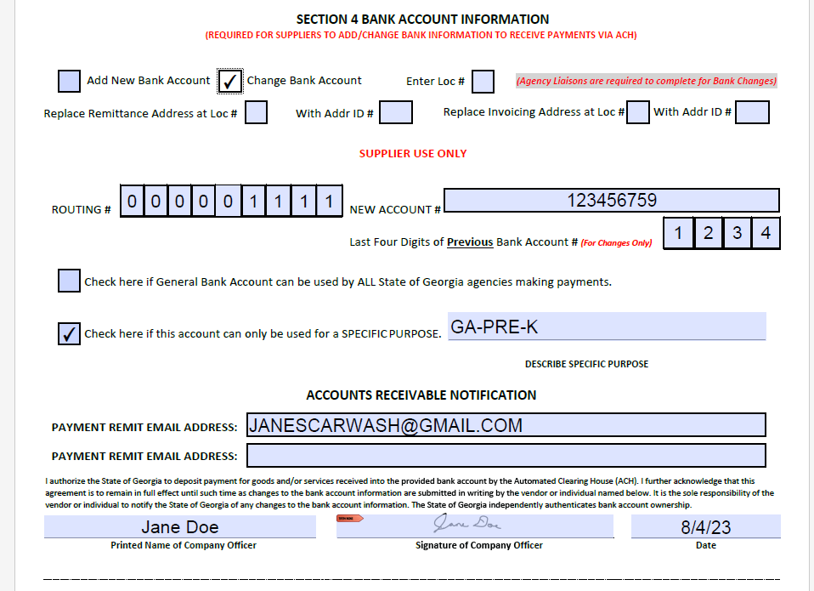
Supplier (vendor) change request form section 4
Change bank account – specific purpose example
Supplier must file out Section 4 completely.
Supplier must check only one if General Bank Account or Specific Purpose.
Enter the last four digits of previous bank account # (For Changes Only)

Slide 15
Common Reasons SCR’s FORMS are Rejected
Incomplete form (Sections)
W-9 is not the current version
TIN# is not complete or does not match W-9
Account or routing number is not complete/correct
Not submitting “Page 2” of SCR form
Contact information is not valid (phone #)

Slide 16
reminders
Date on SCR forms must be within 60 days
W-9 must be dated within the last 365 days
W-9 should be Rev. October 2018 – W-9 prior to this version will not be accepted
New supplier set up – approval time – Estimated 2 weeks (not including weekends/holidays)
Supplier will receive paper checks until banking information is approved
Approval time for Banking – Estimated 5 weeks after the vendor liaison send the request to SAO
Supplier must respond in a timely manner when contacted by SAO
Supplier should never contact SAO unless they contact the supplier first

