Slide 1
Submitting Required Reports and Refutations for Exempt and Informal Providers Part 2
July 1, 2025
Notes:
Hello and thank you for reviewing this recorded webinar. The information presented in this recording is a continuation of a previous webinar that discussed recent updates to Health and Safety Standards and visit updates for exempt and informal programs receiving CAPS subsidies.

Slide 2
Required Reporting and Refutations
Review required reporting- how and what to submit through Decal Koala.
Review and demonstrate how to complete a refutation of visit citations via Decal Koala.
These changes and updates will be available in July 2025
Notes:
The purpose of this presentation is to review the following:
We will review required reporting for programs through program’s decal koala account. Exempt programs with a Decal Koala have been able to complete this previously but there are some enhancements and additions including informal providers now having access to complete required reports.
Additionally, we are going to discuss Refutations- what they are, who can refute citations and the process to complete refutations
This information is geared towards exempt and informal programs that receive CAPS (child and parent services) funding. However, Ex-5 Faith based can report certain items through a required report and we will briefly review this information.

Slide 3
Programs that have a DECAL KOALA account are required to submit certain required reports to the Department.
These programs are:
Informal Providers
Exempt programs with a category 1 or 7 that participates in Childcare and Parent Services (CAPS)
Exempt category 5-Licensed Faith Based

Slide 4
Required Reporting
In accordance with the Child Care and Development Fund (CCDF) requirements, the administrator or designated person-in-charge of exempt programs for categories 1 and 7 that participate in CAPS and Informal Providers, shall report these incidents to the Department within twenty-four (24) hours or the next workday: serious incidents and/or injuries requiring professional medical attention, child abuse or neglect, communicable disease, death of a child,
missing child, fire or structural disaster, emergency relocation of children, any employee that acquires a criminal record, and temporary and permanent closures.
Notes:
What is required reporting for Exempt categories 1/7 and informals

Slide 5
Required Reporting: Previously Licensed Faith-Based Programs, Ex-5
Exempt Programs that are approved for category 5, Licensed Faith-Based shall report accreditation documentation to the Department.
Notes:
Additionally, Exempt Category Ex-5, previously licensed faith-based exemptions, can report their accreditation as a required report as part of the maintaining the approval for Ex-5 exemption.

Slide 6
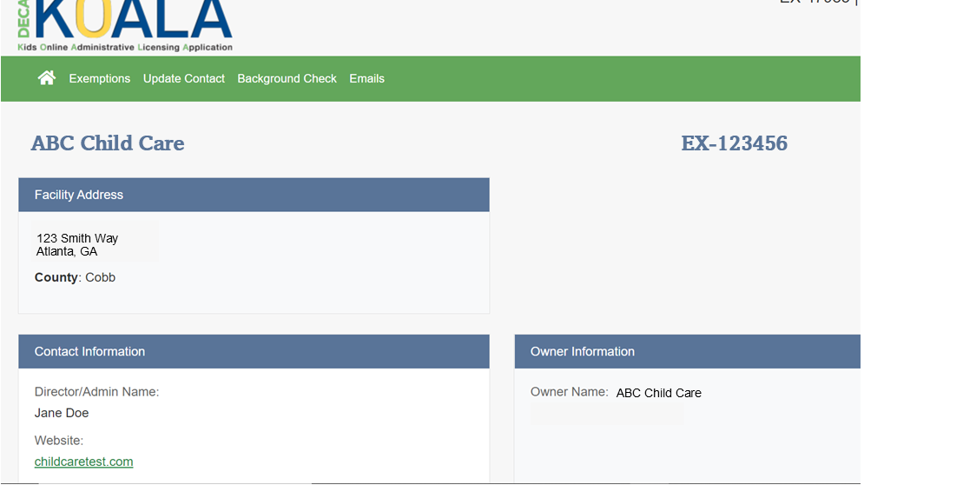
When is a Required Report necessary for Informal providers and exempt programs 1 and 7?
Death of a child while in care
Serious injury requiring hospitalization or professional medical care to a child while in care
Serious illness requiring hospitalization or professional medical care
Child abuse
Missing Child
Fire and/or Structural disaster
Emergency relocation of children
Any employee that acquires a criminal record
Permanent and temporary closures
Notes:
Next we are going to review how to submit a required report through your Decal Koala account.
First, log in to your account.

Slide 7
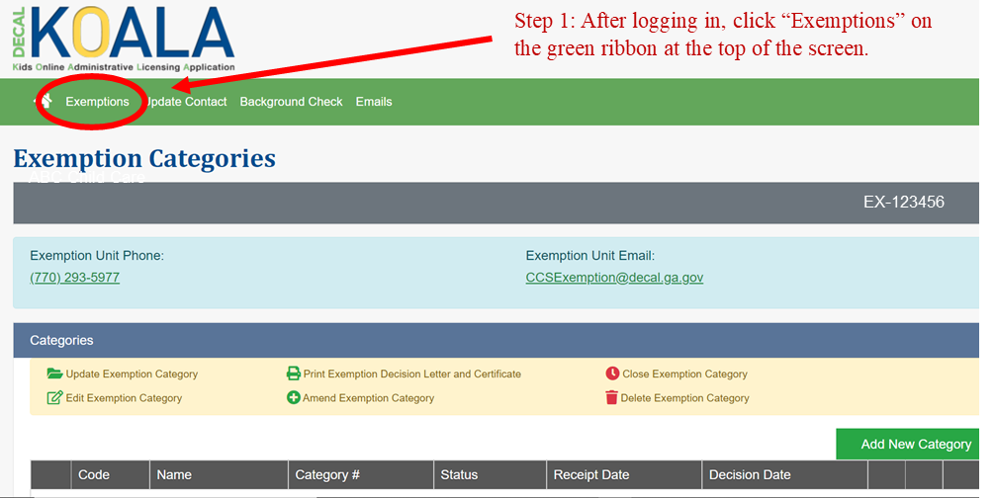
How to submit a Required Report:
Required Reports should be submitted through your DECAL Koala account.
www.decalkoala.com
Notes:
For Exempt programs, click exemptions on the green ribbon at the top of the screen.

Slide 8
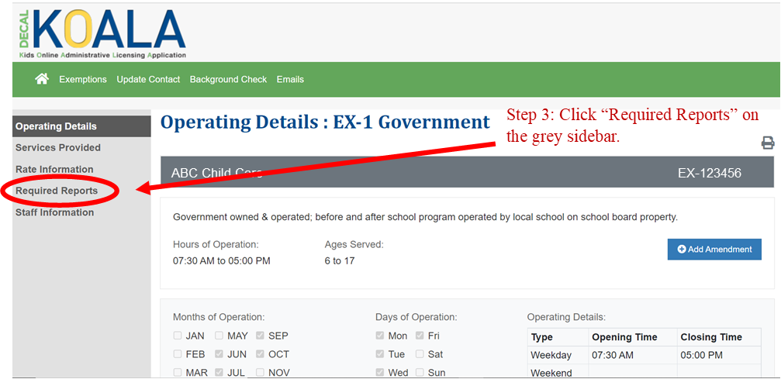
How to submit a Required Report:
Required Reports should be submitted through your DECAL Koala account.
www.decalkoala.com
Notes:
For exempt programs, click the required reports on the left hand side

Slide 9
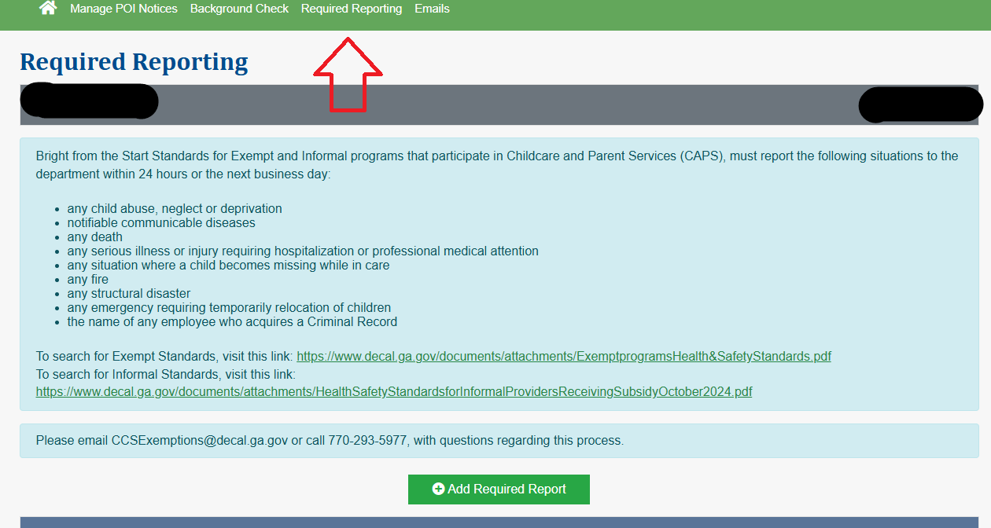
How to submit a Required Report:
Required Reports should be submitted through your DECAL Koala account.
www.decalkoala.com
Notes:
For informal programs, once you log into your Decal Koala, click the Required reporting tab.

Slide 10
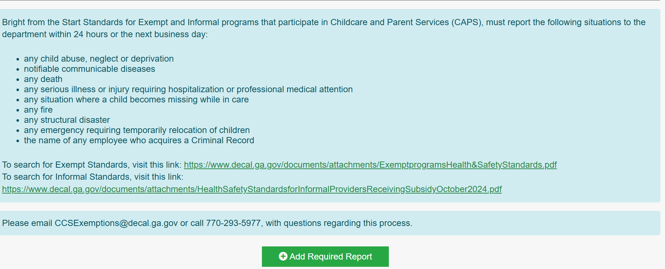
How to submit a Required Report:
Required Reports should be submitted through your DECAL Koala account.
www.decalkoala.com
Notes:
Click the green button at the bottom to add a required report

Slide 11
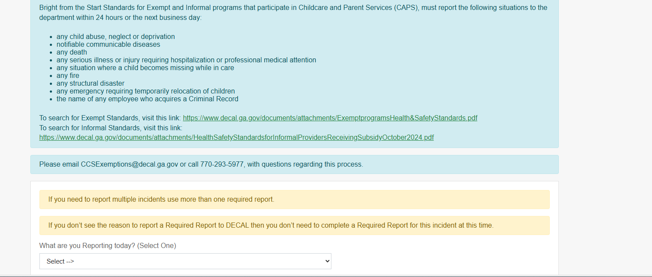
How to submit a Required Report:
Required Reports should be submitted through your DECAL Koala account.
www.decalkoala.com
Notes:
Use the drop-down box to choose what you wish to report.

Slide 12
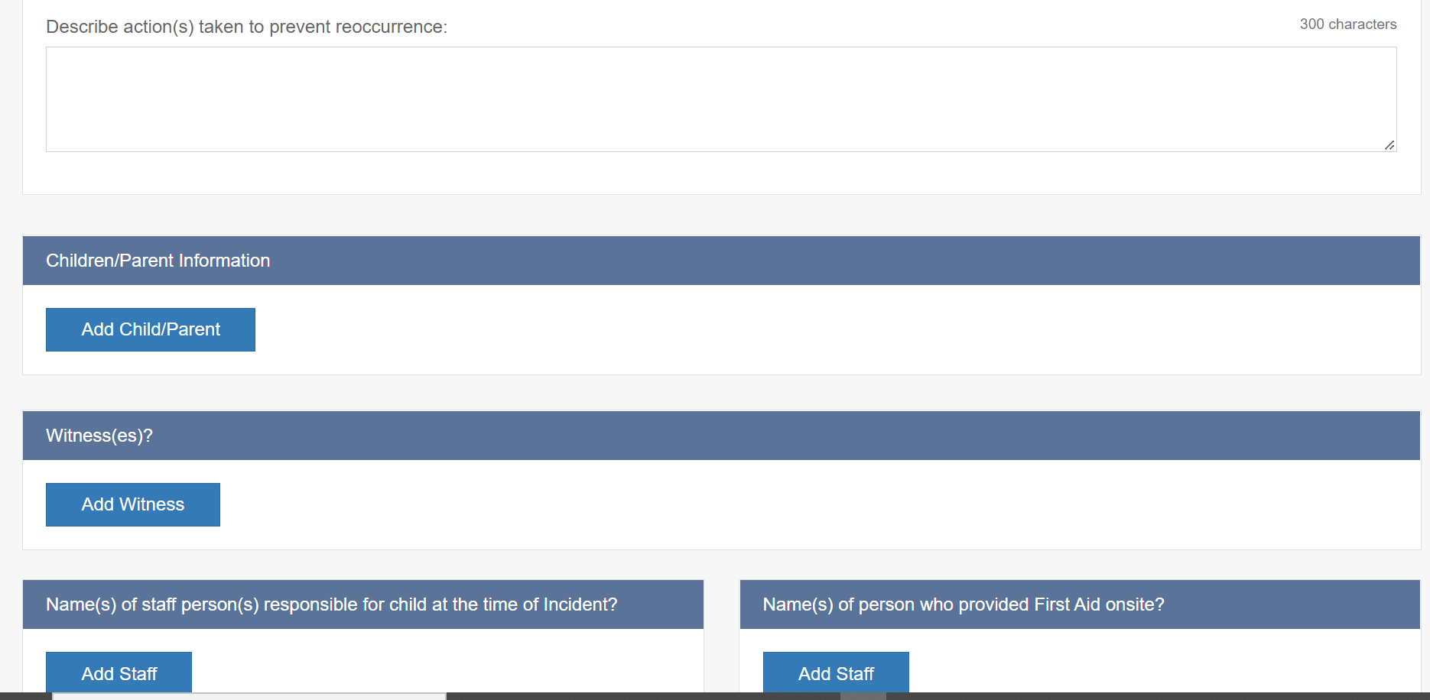
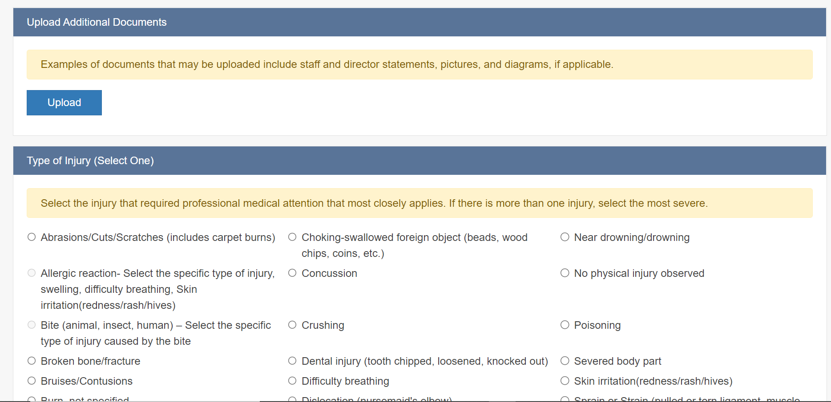
Once in the report you can:
Describe how you will prevent reoccurrence
Add child/parent information
Add witness information
Add staff information
Any action taken
Upload additional documents (statements, pictures, etc.)
Choose the type of injury, affected area of body
Where incident occurred, activity at the time,
Notes:
In the report, you will add information such as parent/child information, ratios, witness, actions taken after. Programs can upload pictures, diagrams, statements as well.
Once the required report is completed and submitted, an exemption specialist will review the report and reach out to the program if additional information is needed.

Slide 13
DECAL Koala: Online Refutations for Informal and Exempt Providers receiving CAPS subsidies
Effective July 2025
Notes:
Switching gears to discuss Online Refutations
We are going discuss the process of submitting refutations for visit citations online through DECAL Koala accounts for exempt and informal programs that receive CAPS subsidies.

Slide 14
What is a Refutation?
A provider has the right to disagree with, ask questions about, and seek further review of a citation(s) issued by a exemption specialist.
If the disagreement about the citation(s) is not resolved by speaking with the specialist, the provider can submit a refutation within 10 business days of the completion date of the visit. This serves as a statement of disagreement/refutation.
Sometimes, citations are removed following review, and sometimes they are not. Providers are encouraged to ask questions and state disagreement with citations and may do so without fear of retaliation or negative consequence.
If a refutation is not received within 10 business days of the visit/completion date, then it is subject to not being accepted.

Slide 15
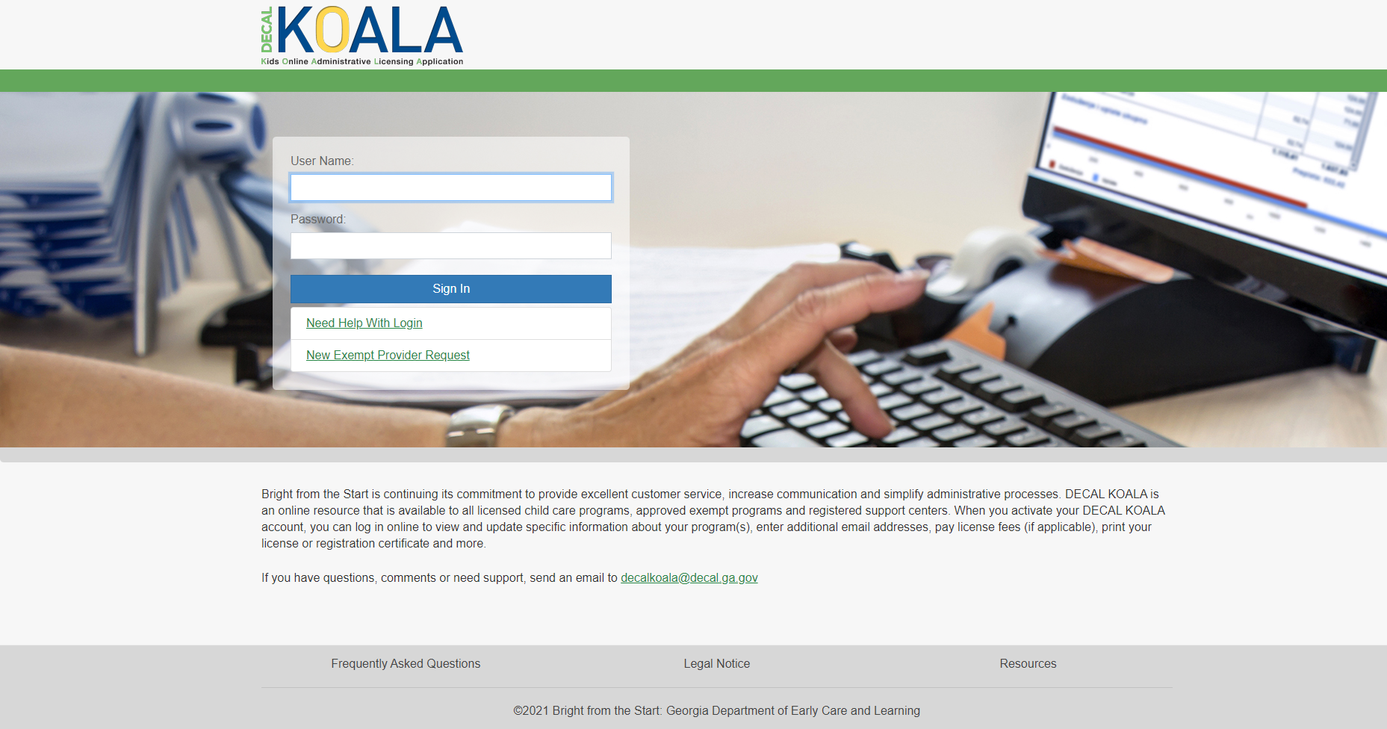
How to submit refutations in DECAL Koala
Notes:
Now I am going to walk you through the process of submitting a refutation through your DECAL Koala Account.
You will log into your DECAL Koala account using you provider number as your username and a password.
*If you have any issues with logging in, please reach out to decalkoala@decal.ga.gov as instructed at the bottom of the log in page.

Slide 16
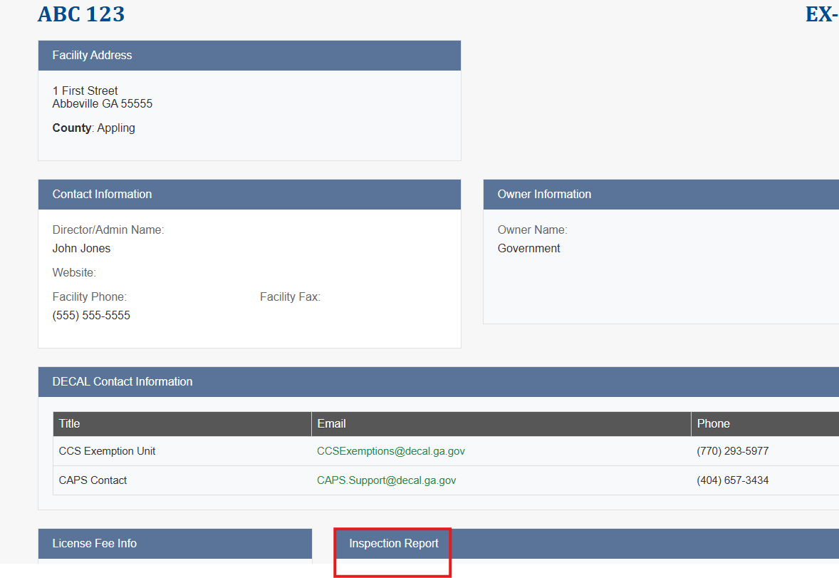
When you log into your DECAL Koala account it will open to your home page. You will scroll down to the inspection report section.
If there was a citation on your last visit, a “Refute Citation” link will be visible. When you click this link, it will take you to the refutation page.
If there was NO citation on your last visit, the “Refute Citation” link will not be visible. But you will still be able to view your visit report.
The “Refute Citation” link will only be visible for 10 business days after the visit date.
Notes:
When you log into your DECAL Koala account it will open to your home page. You will scroll down to the inspection report section.
If there was a citation on your last visit, a “Refute Citation” link will be visible. When you click this link, it will take you to the refutation page.
If there was NO citation on your last visit, the “Refute Citation” link will not be visible. But you will still be able to view your visit report.
The “Refute Citation” link will only be visible for 10 business days after the visit date.

Slide 17
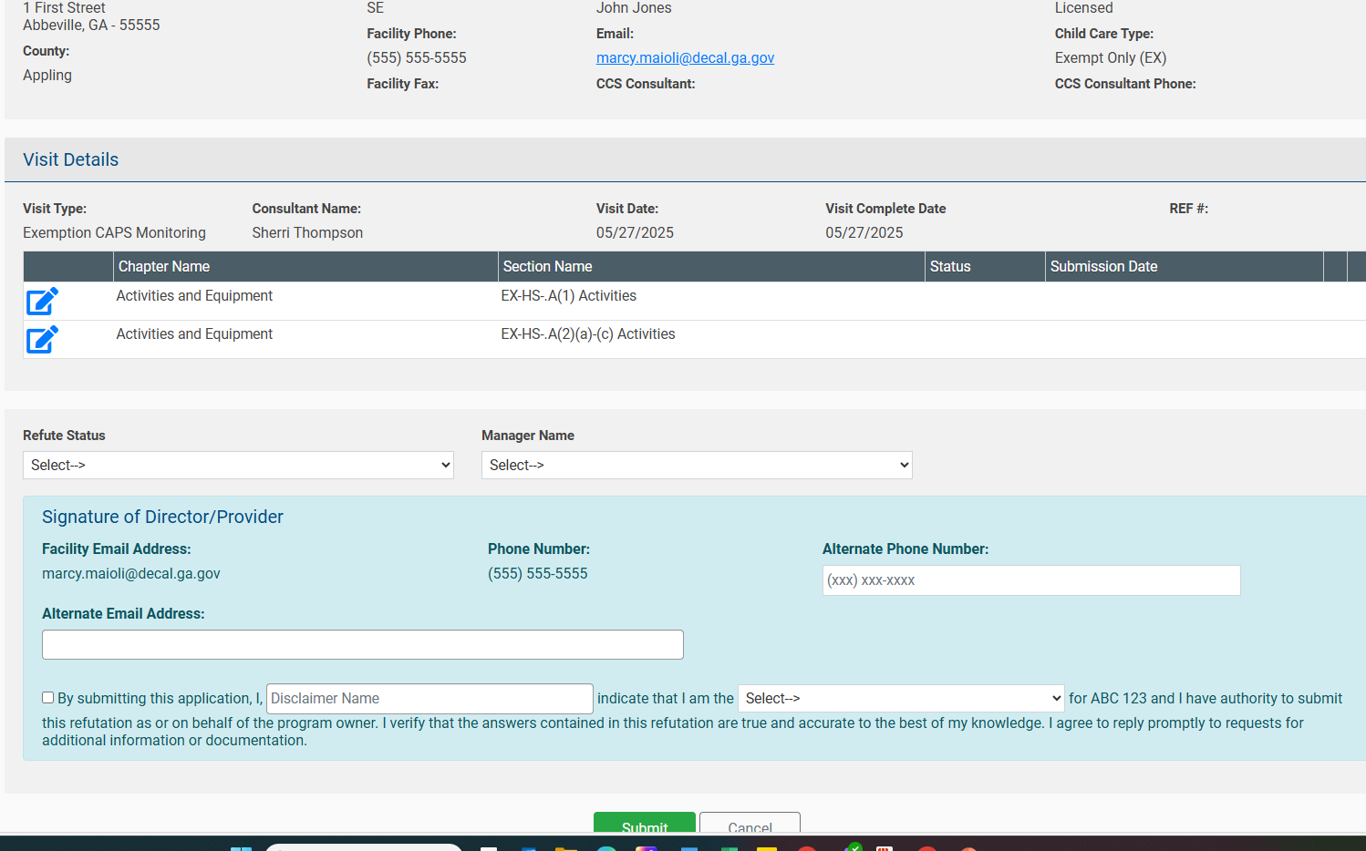
The top of the refutation page shares information regarding the refutation process.
The middle section, Visit Details, shows what standards were cited on that visit.
The bottom section requires the Director/Provider signature once the refutation is ready to be submitted.
Notes:
Once you click refute citation, it will take you into the refutation page.
The top of the refutation page shares information regarding the refutation process.
The middle section, Visit Details, shows what standards were cited on that visit.
The bottom section requires the Director/Provider signature once the refutation is ready to be submitted.

Slide 18
Click on the first pencil icon of the citation you wish to refute to open the following screen.
Notes:
Click on the first pencil icon of the citation you wish to refute to open the following screen.

Slide 19
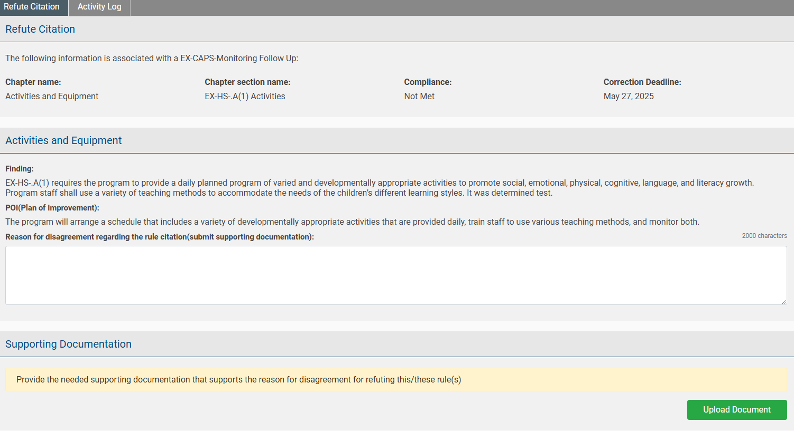
Notes:
When you click on the pencil icon for the citation you have chosen to refute, it will show you the chapter name, section, and the compliance of the standard. You will see the finding which includes what is required for that rule, what you were cited for and the plan of improvement. This section will mirror what is on your visit report that was provided to you at the end of the visit. You will then type in your reason for disagreement regarding the standard citation. Please be detailed in the information you provide to indicate why you disagree with the citation. If you would like to provide any supporting documentation that supports, your disagreement you will upload in the supporting documentation section. Once this section is complete, you will click save at the bottom of the page and it will take you back to the refutation page.

Slide 20
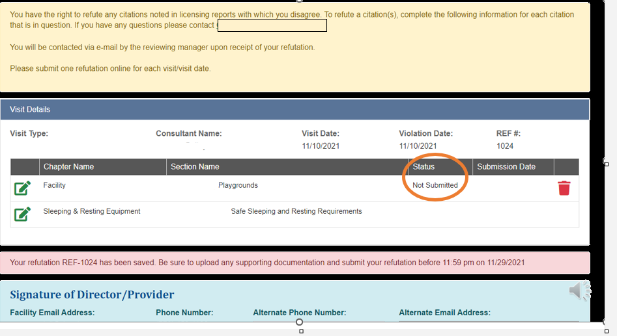
Notes:
When you click on the pencil icon for the citation you have chosen to refute, it will show you the chapter name, section, and the compliance of the standard. You will see the finding which includes what is required for that rule, what you were cited for and the plan of improvement. This section will mirror what is on your visit report that was provided to you at the end of the visit. You will then type in your reason for disagreement regarding the standard citation. Please be detailed in the information you provide to indicate why you disagree with the citation. If you would like to provide any supporting documentation that supports, your disagreement you will upload in the supporting documentation section. Once this section is complete, you will click save at the bottom of the page and it will take you back to the refutation page.

Slide 21
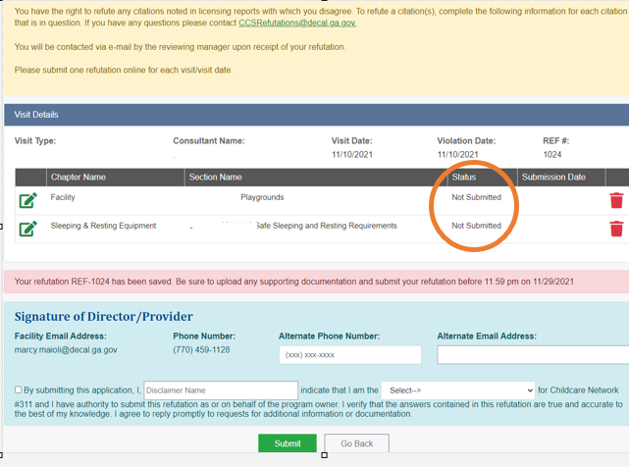
Notes:
Here, both standards have been addressed, but the refutation has not been submitted yet. As a reminder, you do not have to refute each standard that has been cited. You can choose to refute one or multiple standards. If you chose to only refute one stanard, you can proceed to complete the section in blue.

Slide 22
Notes:
When you are ready to submit your refutation, you will fill out the portion in blue and click submit. Once you click submit you will get a note at the bottom of your screen in green, that states your refutation was submitted successfully. Also, the status on the individual standards that’s you refuted will change to “submitted on-line”.

Slide 23
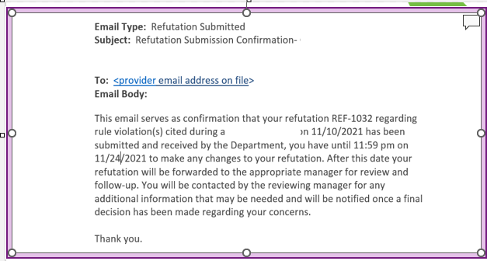
Exaexemple Email: After Submission
Example email after the program submits the refutation.
Notes:
After submitting a refutation, you will receive an email from the system confirming the submission. This email also notifies you of your deadline for making any changes.
If you do not submit the refutation with in 10 business days, it will not be reviewed.

Slide 24
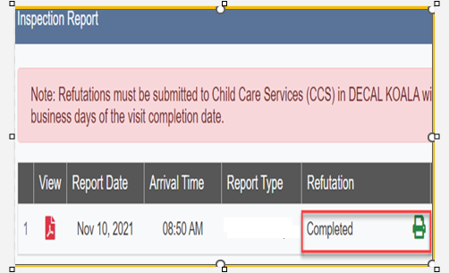
Once your refutation has been completed by the manager, you will receive an email with the refutation letter attached. In DECAL KOALA, the refutation status will show completed and you will be able to print the letter.
Notes:
Once your refutation has been completed by the manager, you will receive an email with the refutation letter attached. In DECAL Koala the refutation status will show completed and you will be able to print the letter. Please note there will be two print icons, one for the refutation.
Additionally, you will receive an email with the decision regarding the refutation.

Slide 25
Refutation Response meanings
Citation changed to Technical Assistance: The citation was removed but changed to a technical assistance comment
Citation Removed: The citation was removed from the visit report.
Citation Removed, alternate rule cited: The original citation was removed but another rule was cited.
Citation Revised: The citation will stand but the wording of the citation will be revised.
Citation Upheld: The citation will stand and will not be removed from the visit.
Notes:
In the letter, it will say what changes if some will be made to your citation. There are 5 potential responses to your refutation.
Citation Changed to Technical assistance
Citation was removed from the visit
Citation was removed but an alternate rule was cited
Citation was revised
Or Citation Upheld and will not be removed from the visit.

Slide 26
If you have any questions, please email decalkoala@decal.ga.gov or exemptionrulechanges@decal.ga.gov
Notes:
Thank you for reviewing the recorded webinar. For questions regarding your decal koala account please email.
For general questions regarding exemptions or informals, please email

