Slide 1
Quality Initiatives
Advisory Committee
February 24, 2012
Bobby D. Cagle, MSW, Commissioner
Bright from the Start:
Georgia Department of Early Care and Learning

Slide 2
AGENDA
Welcome and Meeting Purpose
Goals and Objectives of the Advisory Committee
Quality Initiatives Overview
Wrap Up and Next Steps

Slide 3
Goals and Objectives of the Advisory Committee
Provide targeted stakeholders an opportunity to speak directly with Commissioner Cagle on a regular basis
Inform the department of local issues with DECAL programs
Identify and discuss the impact of statewide trends
Provide feedback on proposed program and rule changes

Slide 4
Meeting Information
Two meetings per year and as needed
  Held via conference calls and webinars
Subcommittees will be formed to address specific issues facing DECAL
Term: One year

Slide 5
DECAL Advisory Committees
Georgia’s Pre-K Program
  Superintendents
  Directors/Principals (Public)
  Directors/Owners (Private)
  Teachers
  Parents
Child Care Services
  Directors/Owners (Child Care Center, Family/Group Day Care Home)
Quality Initiatives
  Quality Rated
  Infant/Toddler Network
Faith Based Programs
Philanthropy
Nutrition
Business

Slide 6
Expectations for Departmental Stakeholder Engagement
A wide variety of stakeholders will be consulted before major changes occur in regulation, policy, or agency practice.
Providers
Consumers
Advocacy Organizations
Provider Organizations

Slide 7
Quality Initiatives Overview
Quality Initiatives
Infant Toddler Network
Statewide Inclusion
Project
Child Care Resource and Referral Agencies
Accreditation Facilitation
Even Start
SCHOLARSHIPS and INCENTIVES
Quality Rated
Summer 2012
Child Care Subsidy (CAPS)

Slide 8

Notes:
Quality Rated is Georgia’s new tiered quality rating and improvement system. A Tiered Quality Rating and Improvement System provides a systematic approach to ASSESS, IMPROVE and COMMUNICATE the level of quality in early care and education programs. The system provides industry standards that exceed state licensing requirements. These research-based standards address: a) Ratios and Group Size; b) Staff Qualifications; c) Child Health, Nutrition and Physical Activity; d) Family Partnerships; and e) Intentional Learning Practices.
Expected Outcomes:
Increase the quality of available and accessible ECE.
Increase parents’ understanding of and demand for higher quality ECE.
Increase professional development opportunities, benchmarks, and rewards for ECE professionals.
Align standards, technical assistance, monitoring, finance, and consumer education for ECE programs in a range of settings, including family child care homes, child care learning centers, school-based programs, and Head Start.

Slide 9

Quality Rated Logic Model
OUTCOMES | Increase Child Outcomes Increase School Readiness and Reduce the Achievement Gap Increase Enrollment in High Quality, Responsive Early Care and Education Programs
Long Term Goals | More children in Quality Rated programs Parents under-select low quality programs | Fewer lower-rated programs Quality Rated is part of early care and education culture
Short Term Goals | Understand quality indicators for early care and education Understand connection between quality early care and education and child’s school readiness | Quality Rated participation and quality improvement plans established at 700 programs in 2012 Recognition of quality indicators
 | FAMILIES | PROGRAMS
Input | QUALITY RATED, Voluntary Provider Participation, Public and Private Funding
Notes:
This is an abbreviated logic model for Quality Rated. The logic model illustrates the outcomes that we want to achieve: children who begin kindergarten ready to excel in school; a reduction in the achievement gap for high needs children; and an increase in the number of children enrolled in high-quality, responsive early care and education programs.
To achieve these outcomes, we have identified initial goals, intermediate goals, and long term goals related to families and programs.
To achieve these goals, we start with “inputs”: Quality Rated, voluntary provider participation in Quality Rated, and public and private funding to support Quality Rated.
The activities that support Quality Rated are technical assistance and professional development to help programs improve quality and assessments to measure program quality.
Outputs are programs’ quality improvement plans; the programs that achieve a quality rating; programs that earn incentives and tiered reimbursement. Another output is the public awareness campaign that helps families understand the importance of quality early education and identify Quality Rated programs.

Slide 10
Quality Rated Data
(as of February 22, 2012)
677 registrations for Quality Rated orientation
380 programs serving 31,752 children have applied
Breakdown of Children with High Needs (Self-Reported Data)
4,149 (13%) | Child care subsidy/CAPS recipients
4,162 (13%) | PeachCare for Kids recipients
1,401 (4%) | English language learners
825 (3%) | Children with Disabilities
360 (1%) | Live in foster homes
76 (0.2%) | Homeless
8 (0.02%) | Live with migrant workers
Notes:
Quality Rated was launched on January 3, 2012. By February 22, 677 individuals had registered to attend Quality Rated orientations. 375 programs serving over 31,000 children applied to participate in Quality Rated.
Research shows that children are better prepared for kindergarten when they attend high quality early education programs; children with high needs benefit the most. The programs enrolled in Quality Rated serve children with high needs.

Slide 11
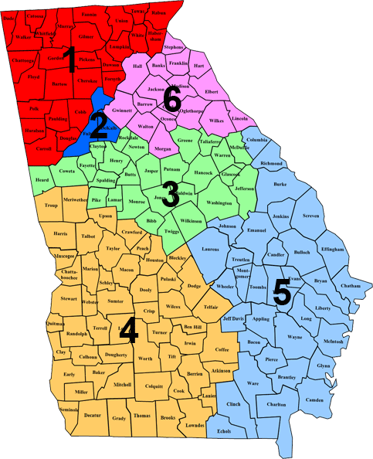
Programs Enrolled by Child
Care Resource & Referral Region
83 Counties represented | Quality Rated Applications | Facilities* | Percentage
Region 1 | 94 | 920 | 10.2%
Region 2 | 77 | 1,150 | 6.6%
Region 3 | 47 | 800 | 5.9%
Region 4 | 44 | 877 | 5.0%
Region 5 | 63 | 973 | 6.5%
Region 6 | 55 | 759 | 7.2%
Total | 380 | 5,479 | 6.9%
* Includes only compliant licensed or registered programs
Notes:
Data on February 22, 2012.
Programs across the state (83 counties, so far) have enrolled in Quality Rated. This chart shows the number programs that have enrolled by child care resource and referral region. The number of facilities in the middle column is the of number of compliant licensed and registered programs in that region; it does not include all facilities that may be eligible to participate such as Georgia’s Pre-K classes in public schools or Department of Defense programs.

Slide 12
Quality Rated Launch Year
During 2012, the first year of Quality Rated, DECAL will study the Quality Rated process, analyze the rating system, and listen to provider and stakeholder feedback.
We will work with focus groups and compile and study data regarding the program.
A child care program’s quality rating will NOT be publicized during the first 12 to18 months of Quality Rated.
Notes:
During 2012, the first year of Quality Rated, DECAL will study the Quality Rated process, analyze the rating system, and listen to provider and stakeholder feedback.
We will work with focus groups and compile and study data regarding the program, especially the percentages of programs achieving the three proposed rating tiers.
A child care program’s quality rating will NOT be publicized during the first 12 to18 months of Quality Rated.

Slide 13
Quality Rated Launch Year
With feedback from participating programs and the researchers, we will make decisions regarding the process for assigning ratings before making the ratings public on the DECAL website.
We will work closely with you to share ratings with parents and the public in a way that will help them identify the early care and education programs that will best meet their needs.
Notes:
With feedback from participating programs and the researchers, we will make decisions regarding the process for assigning ratings before making the ratings public on the DECAL website.
We will work closely with you to share ratings with parents and the public in a way that will help them identify the best early care and education programs that fit their needs.

Slide 14
Quality Rated Launch Year
The Childcare and Parent Services (CAPS) subsidy program is expected to transition from the Georgia Department of Human Services to DECAL in July 2012.
The plan is to provide tiered reimbursement to Quality Rated programs that serve children in the CAPS program.
Notes:
The Childcare and Parent Services (CAPS) subsidy program is expected to transition from the Georgia Department of Human Services to DECAL in July 2012.
The plan is to provide tiered reimbursement to Quality Rated programs that serve children in the CAPS program in 2012 when ratings are published.

Slide 15
Supporting Cultural Competency in Quality Rated
Georgia selected to receive a technical assistance grant from the QRIS National Learning Network and the Build Initiative
Technical assistance will focus on building greater cultural and linguistic competence in Quality Rated
Technical assistance partner is Camille Catlett, Scientist, FPG Child Development Institute, University of North Carolina‒Chapel Hill
Notes:
Technical assistance

Slide 16
Questions and Feedback

Slide 17
Looking for Your Feedback
How can we help parents identify quality in early care and education programs?
What feedback are you hearing in the field about Quality Rated?
What supports are still needed in the field to enhance quality in early care and education programs?
Notes:
What symbols should be used to designate the Quality Rated levels?

Slide 18
Wrap Up and Next Steps

